Slide 1
ASP.NET MVC CORE
Instructor: Edwin oduor

Slide 2

Quote of the day

Slide 3
Lesson objectives
Joins
LINQ Queries to join Tables

Slide 4
Lesson pre-requisites
In order to take full advantage of this section you need to have the following;
Computer with Visual Studio Installed.
Stable Network Connection.

Slide 5
Training methods and extra readings
TRAINING METHODS FOR THIS LESSON
EXTRA READINGS
Lecturing Method – This is the main method of training to be adopted in this lesson with illustrations and practical coding examples.
Discussion Method - This method will be adopted periodically whereby learning will be derived principally from the students brainstorming together, rather than from the trainer. Three main types of discussions will be used:
Directed discussion
Developmental discussion
Problem-Solving discussion
Home and Learn C#

Slide 6
LINQ Queries to join Tables.

Slide 7
LINQ makes it possible to write join queries then after writing the query we can go ahead and display the content in a view.
In our case we will write join query to join students table and fees table so that we can display students who have school fees balance.
In our Fee Repository we will create a method in the method will use LINQ.

Slide 8
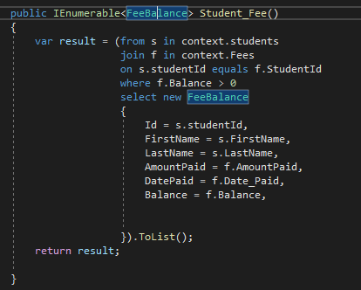
Method in the Fee Repository.
FeeBalance is a class that contains the fields that we will use.

Slide 9
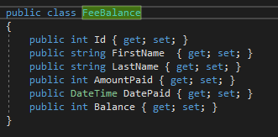
This is our FeeBalance class.
It has the fields that we want to use to display on the view.

Slide 10
Back to our Student_Fee method
in our method we are creating a variable result then writing a LINQ QUERY, context.students and context.Fees are the two tables that we want to join, then using where clause so that it can filter students who have school Fees balance. After the where clause we are now specifying the fields that we want included in query the query.

Slide 11
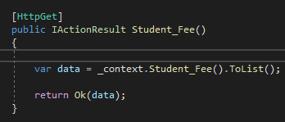
After that is done, Next is to go our controller and add a method.
A variable is declared then handing the Student_Fee to the variable, the Student_Fee is being retrieved from the IFeeRepository.
Next will create a view, in our view will create a table as shown in the next slide.

Slide 12
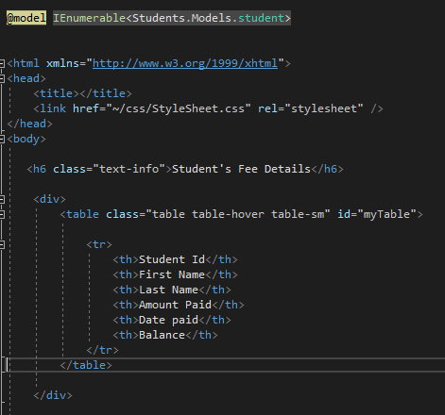
This is the table that we are creating.

Slide 13
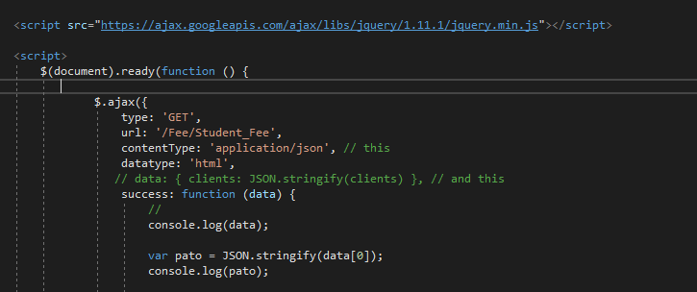
Then below the div will code that get the json data and put it inside a table.

Slide 14
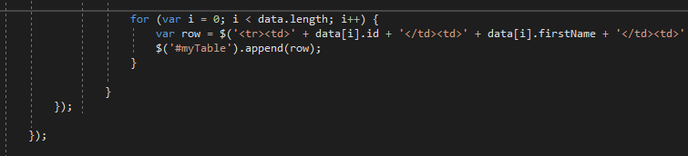
Continuation of the previous code.
This is the continuation of the line where variable (row) has been declared, it is long can’t fit on the screen
In our _layout we need to write code so that when a user clicks on the link then the query will be shown.

Slide 15
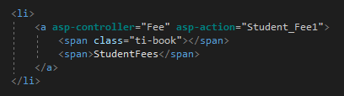
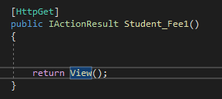
Code in the _layout
In our controller will then have this method. This is the method that will call the above view.

